Slide 1

CTD Python Essentials
Week 2 – Data Structures and File Handling

Slide 2

list
Mutable sequential data structure indexed with integers
Implemented as dynamic arrays in contiguous memory
O(1) index and append unless resizing (O(n)) is needed
Accessing via index
my_list[<index>] where index is zero based
my_list[<start>:<one-past>] returns a new list which is a slice
Omitting the first implies the beginning, omitting the last implies the end
[:] returns a shallow copy
Negative indices start from the end instead of the beginning
Use len() to find the length of a list
Generic for any container in python
Or anything which implements __len__()

Slide 3
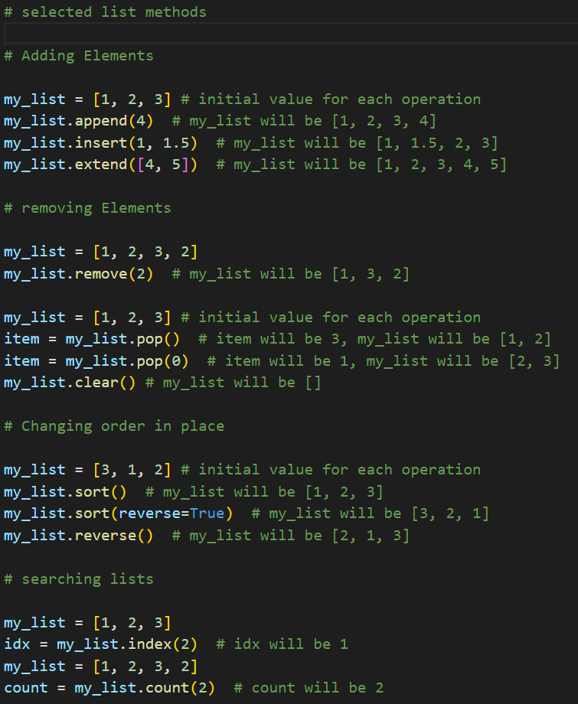
List Methods
Lists supports lots of methods and operations
Common sequence operations
Mutable sequence operations
Explicit conversion via list()

Slide 4
tuple
Tuples are immutable sequential data structures
Implemented as a fixed sized array in contiguous memory
More efficient than lists (no resizing mechanism)
Support all of the common sequence operations
Can be treated like lists except for operations which make changes in place (mutate)
Tuples can be used as dict keys and can be added to sets
lists can not

Slide 5
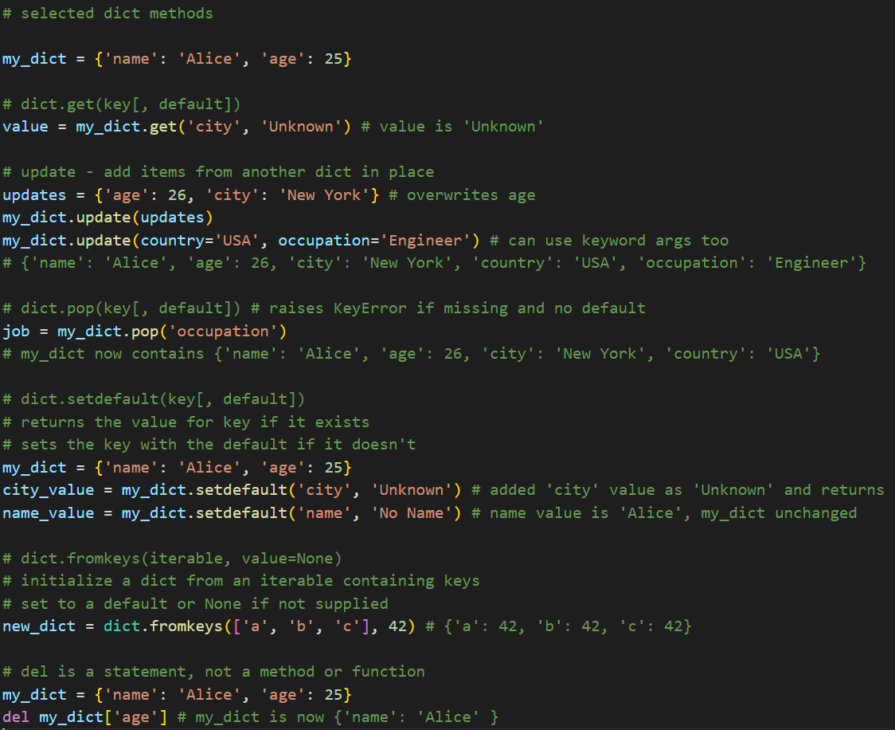
dict
A mutable mapping data structure
key/value pairs
Associative array
Implemented as hash tables
Lookup is efficient
Constant time lookup when there are no collisions
Unlikely worst case of O(n) when everything collides
These are the methods and operations supported by dicts
Key lookup and assignment using my_dict[<key>]
Keys must be hashable
Immutable and can be compared to other objects
Iterating
The dict itself provides an iterator over keys
The values() methods provides an iterator over values
The items() method provides an iterator over (<key>, <value>) tuples
Size via the len() generic function
remove everything using the clear() method
shallow copy using the copy() method

Slide 6
Iterables and Iterators
An Iterable is any Python object capable of returning its elements one at a time
lists, tuples, strings, dictionaries, and sets
Anything which implements __iter__()
Can be used in a for loop
An Iterator is a lazy data structure which generates values one at a time as needed rather than all up front.
Efficient for very large data streams
Can be used in a for loop
range() returns an iterator
iter() converts a sequence to an iterator
dict.items() returns an iterator over key/value tuples
map() and filter() return iterators
Anything which implements __iter__() and __next__() is an iterator

Slide 7
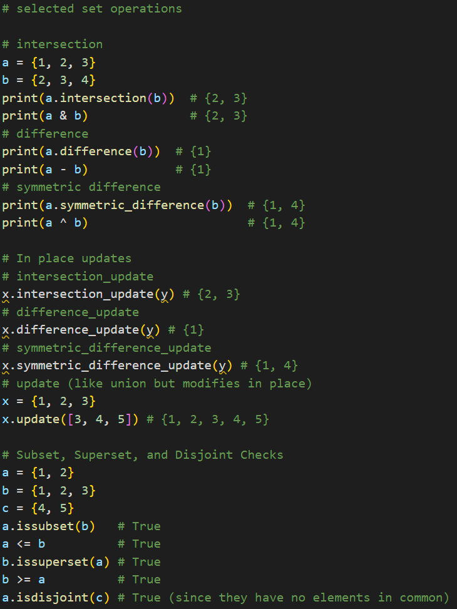
set
A mutable collection datatype which models sets
Useful for uniquifying a collection
Objects added to sets must be hashable
Construction and explicit conversion using set()
Can also use e.g. {‘a’, ‘b’, ‘c’} as a set literal
Use the add() method to add items
Check membership using in or not in
Use remove() to remove an item
discard() removes an items but does not check whether it exists
The copy() method creates a shallow copy
The clear() method creates empties the set
These are the methods and operations supported by sets

Slide 8

File Handling
The open function is used to create a file object
Sometimes referred to as a file handle or file descriptor
Establishes a connection with the operating system for input/output operations.
Important to close() a file object when you are done
For example write data is not necessarily saved to disk until it is closed
Typical modes
‘r’ read from a file
‘w’ write to a file, overwrites an existing content
‘a’ append to a file, write after existing content
Defaults to a text file. Binary and buffered binary are also supported
Common methods
read() reads the whole file, readline() reads single lines
Typically the iterator is used : for line in file_object:
Does not strip newlines, use strip() for that
write() – does not include a newline (add ‘\n’)
The with statement is usually used for file operations since it automatically closes open file objects on exit
It’s important to trap exceptions for file operations
Formatted strings: f’string content {<variable-value-inserted>} more string content}’

Slide 9

CSV and JSON
The python standard library provides modules for conveniently accessing a variety of standard file formats.
CSV is frequently used for import and export of spreadsheets and databases
JSON data is also well supported
Later in the class, we will use pandas DataFrames
These use their own methods to access csv and json

Slide 10

Modules and Libraries
Python provides a convenient module system for managing name spaces
Break programs up into multiple files
Avoid accidental name collisions
Usage
import <module-name> # file name with no quotes or .py suffix
import <module-name> as <shorter-name>
To access names inside the module, qualify it with the module name
<module-name>.<name-in-module>
Module search order
Built in
Local files
The PYTHONPATH environment variable
site-packages for the local installation
For more complex projects you can create python packages
Standard structure for project management
Can manage multiple hierarchical modules together

Slide 11

Keyboard input
The built in function input([<prompt>]) is used for keyboard input
It prompts the user with the optional prompt string and returns a string with the newline removed

Slide 12

Interacting with the OS
The os module provides a portable way to access operating system information
os.chdir(path) # change the working directory
os.getcwd() # get the current working directory
os.getenv(key, default=None) # get an environment variable
The sys module is used to access system specific information
sys.argv # list of command line arguments where argv[0] is the script name
The argparse module provide a feature rich way to specify and capture command line arguments
Use it for all but the most simple cases
Generates help messages

Slide 13
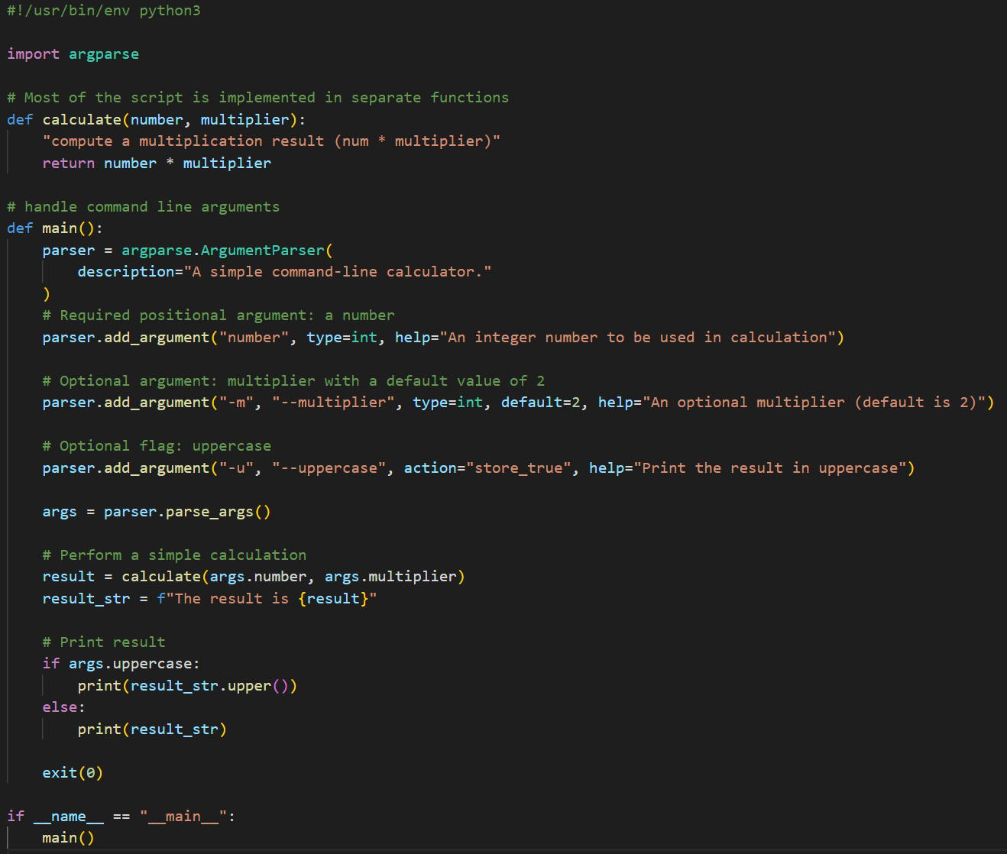
Command line scripts

Slide 14
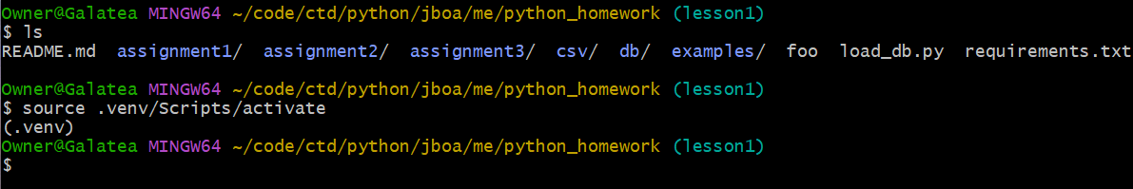
Virtual Environments
Python provides a convenient way to manage package dependencies using virtual environments
Specific interpreter, modules, libraries and binaries for a given project
Standard practice is not to add the venv to the versioning system
Instead reproduce it as needed (manage requirements.txt version)
pip install -r requirements.txt # list of packages and revision numbers
Steps
python -m venv .venv # the last argument can be any file path
source .venv/bin/activate # or source .venv/Scripts/activate on Windows
Make sure you see (.venv) in your prompt

Slide 15

Q&A and Demo

